Slide 1
Project Management
Engineering Software as a Service
© 2012 David Patterson & David Patterson
Licensed under Creative Commons Attribution-NonCommercial-ShareAlike 3.0 Unported License

Slide 2

It Takes a Team: Size & Scrum
Engineering Software as a Service §10.1

Slide 3

SW Eng now a Team Sport
Now in Post-Superhero- Programmer Era
Rising bar of functionality/quality => cannot do SW breakthrough alone
Successful SW career => programming chops AND plays well with others AND can help make team win
“There are no winners on a losing team, and no losers on a winning team.”
Fred Brooks, Jr.
Notes:
Early in my career knew superhero programmers – go away for weekend and build amazing breakthrough
Ken Thompson, co-inventor of UNIX, won Turing Award, was a Berkeley student
Bill Joy, led BSD UNIX, which was first open source project, hero programmer – wrote vi over long weekend
No longer individuals building amazing things – Linus Torvald leads open source around Linux, but not done by himself
Early – bar was low
Not that many superheroes
What does team need to win (do you need to do more than your part)

Slide 4
Example: Video Games
Game | Year | Platform | Dev Team
Space Invaders | 1981 | Arcade console | 1
Super Mario Bros. | 1985 | NES (Nintendo) | 8
Sonic the Hedgehog | 1999 | Sega Dreamcast | 30
Resident Evil 6 | 2013 | PC, PS3, Xbox 360 | 600

Slide 5
Alternative Team Organization?
Plan-and-document require extensive documentation and planning and depends on an experienced manager
How should we organize an Agile team?
Is there an alternative to a hierarchical organization with one manager who runs the project?

Slide 6

Scrum: Team Organization
“2 Pizza” team size (4 to 9 people)
“Scrum” inspired by frequent short meetings
15 minutes every day at same place and time
To learn more: Agile Software Development with Scrum by Schwaber & Beedle
Notes:
Bezos, lots of companies, (2 pizza teams in more people)
Need a way to self-organize
Scrum – penalty
Standup Meeting
Its 9:08, over by 9:23
What happens at meeting – go

Slide 7
Daily Scrum Agenda
Answers 3 questions at daily scrums:
What have you done since yesterday?
What are you planning to do today?
Are there any impediments or stumbling blocks?
Help individuals by identify what they need
Notes:
Go around in a circle
By understanding what each team member was doing, the team can identify work that would help others make more rapid progress
This would unblock me if you would do this first
Most is common sense

Slide 8
Scrum roles
Team: 2-pizza size team that delivers SW
ScrumMaster: team member who
Acts as buffer between the Team and external distractions
Keeps team focused on task at hand
Enforces team rules (coding standard)
Removes impediments that prevent team from making progress
Product Owner: A team member (not the ScrumMaster) who represents the voice of the customer and prioritizes user stories
Notes:
Not the manager – SM is supposed to be the buffer so team can concentrate

Slide 9
Resolving Conflicts
Ex: Different view on right technical direction
First list all items on which the sides agree
Each side articulates the other's arguments, even if don't agree with some
Avoids confusion about terms or assumptions, which may be real cause of conflict

Slide 10
Resolving Conflicts
Constructive confrontation
If you have a strong opinion that a person is proposing the wrong thing technically, you are obligated to bring it up, even to your bosses
Disagree and commit
Once decision made, need to embrace it and move ahead
“I disagree, but I am going to help even if I don't agree.”
Conflict resolution useful in personal life!

Slide 11
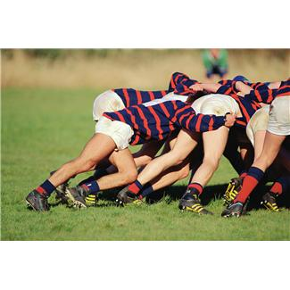
Scrum Summary
Basically, self-organizing small team with daily short standup meetings
Work in "sprints" of 2-4 weeks
Suggest members rotate through roles (especially Product Owner) each iteration
Notes:
Only 2 roles
Instead of iterations, do sprints when ready
Help if each take turns
Pivotal Labs actually puts customer at PL comes to the daily scrums

Slide 12
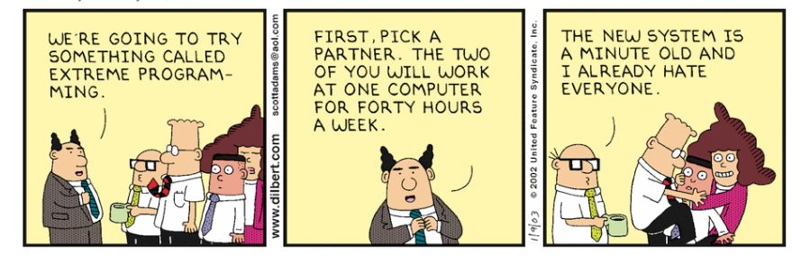
Pair Programming
Engineering Software as a Service §10.2

Slide 13
Pair Programming
Goal: improve software quality, reduce time to completion by having 2 people develop the same code

Slide 14
Are 2 minds better than 1?
Stereotype: lone wolf working all night drinking Red Bull
Is there a more social way to program?
What would be benefits of multiple people programming together?
How would you prevent one person from doing all the work while the other gets coffee and checks Facebook

Slide 15
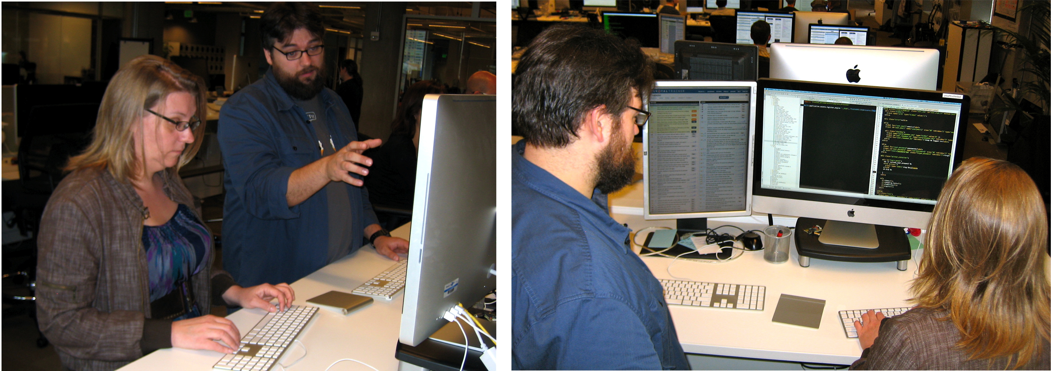
Pair Programming
Sit side-by-side facing screens together
Not personal computer; many for any pair to use
To avoid distractions, no email reader, browser
Notes:
Sarah Mei and JR Boyens at Pivotal Labs
We know that MultiTasking is distracting, so these are real workstations with no facebook, email, twitter, …
Don’t check email between 8AM and 5PM
Productivity improves
New employees say tired after 8 hours
Go home at night and don’t do programming at home
SV Management technique is buying dinner

Slide 16
Pair Programming
Driver enters code and thinks tactically about how to complete the current task, explaining thoughts while typing
Observer reviews each line of code as typed in, and acts as safety net for the driver
Observer thinking strategically about future problems, makes suggestions to driver
Should be lots of talking and concentration
Pair alternate roles
Notes:
Talking out loud while work (like surgeon on TV)
Driver short term, Observer long term
Have to Alternatve

Slide 17
Pair Programming Evaluation
PP quicker when task complexity is low
PP yields higher quality when high
Anecdotally, sometimes more readable code too
But more effort than solo programmers?
Also transfers knowledge between pair
programming idioms, tool tricks, company processes, latest technologies, …
Some teams purposely swap partners per task => eventually everyone is paired (“promiscuous pairing”)
Notes:
But Pivotal Labs denies it
More senior and more junior
“promiscuous pairing”
Does it factor in distraction

Slide 18
Pair Programming Do's & Don'ts
Don't fiddle with your smartphone when you are the observer
Do consider pairing with someone of different experience level—you'll both learn!
Explaining is a great way to better understand
Do swap frequently—learning goes both ways, and roles exercise different skills
Observer gains skill of explaining his/her thought process to Driver
Notes:
Concentrate on task at hand (not phone)
Great if mismatch to learn

Slide 19
Design Reviews, Code Reviews, Plan-And-Document Perspective on Project Management
Engineering Software as a Service §10.3, §10.7-10.9

Slide 20
Design/Code Reviews
Design review: meeting where authors present design
benefit from experience of attendees
Code review: held after design implemented
Notes:
Once implemented –
Fit better with P&D

Slide 21
Review Agenda
Prepare with list of questions/ issues like to be discussed
Start with High-Level Description of Customer Desires
Give SW architecture, showing APIs and highlighting Design Patterns (Ch. 11) at each level of abstraction
Go through code and documentation: project plan, schedule, testing plan, …: Verification and Validation (V&V) of project
Notes:
All but last of these useful for Agile reviews too

Slide 22
Good Meetings: SAMOSAS
Start and stop meeting promptly
Agenda created in advance; no agenda, no meeting
Minutes recorded so everyone can recall results
One speaker at a time; no interrupting talker
Send material in advance, since reading is faster
Action items at end of meeting, so know what each should do as a result of the meeting
Set the date and time of the next meeting
Minutes and action items record results of meeting, start next meeting by reviewing action items
Notes:
Going to spend a lot of time at poorly run meetings.
7 letters too long, but maybe will remember some. We’ve been using it in our meetings.
When does it start – Berkeley Time? On the hour? E.g., start at 10:08
Writtenin advance; cancel if none
Someone writes down the minutes
Embraced the rude speaker model – let people complete thoughts, OK to let people breather
Read at Action Items
Common sense – like your meetings, we got a lot done,

Slide 23
Better Reviews?
Shalloway*: formal design and code reviews often too late in process to make big impact
Recommends instead have earlier, smaller meetings: "approach reviews."
A few senior developers assist team in coming up with an approach to solve the problem
Group brainstorms about different approaches
If do a formal design review, suggests 1st hold a "mini-design review" to prepare
*Alan Shalloway, Agile Design and Code Reviews, 2002,
www.netobjectives.com/download/designreviews.pdf
Notes:
Big process, usually too late to have impact,
Do before have review that companies require

Slide 24
Quantitative Metrics vs. Reviews?
Study many projects to record averages, set baseline for new projects, compare this one:
Code size (KLOC), Effort (months)
Milestones fulfilled, Test cases done
Defect discovery, repair rate / month
Correlated so that can replace reviews??
However, we are still quite a long way from this ideal situation, and there are no signs that automated quality assessment will become a reality in the foreseeable future — Sommerville 2010

Slide 25
Agile and Reviews?
Pivotal Labs – Pair programming means continuous reviewing => no special reviews
GitHub – Pull Requests instead of reviews
A developer requests his/her code be integrated into main codebase
All developers see each request and determine how might affect own code
If concern, online discussion on pull request
As occur daily, "mini-reviews" continuously
no special reviews
Notes:
Pair is continuous reviews
Pull requests everyday

Slide 26
Fixing Bugs: The Five R's
Engineering Software as a Service §10.7

Slide 27
No Bug Fix Without a Test!
Report
Reproduce and/or Reclassify
Regression test
Repair
Release the fix (commit and/or deploy)
Even in non-agile organizations
Existing agile processes can be adapted to bug fixes

Slide 28
Report
Pivotal Tracker
bug = 0-points story (but not zero effort!!)
automation: GitHub service hooks can be configured to mark Tracker story "delivered" when properly-annotated commit is pushed
GitHub "issues" feature
Full-featured bug tracking, e.g. Bugzilla
Use the simplest tool that works for your team and project scope

Slide 29
Reclassify? or Reproduce + Repair?
Reclassify as "not a bug" or "won't be fixed"
Reproduce with simplest possible test, and add it to regression
minimize preconditions
Repair == test fails in presence of bug, passes in absence of bug
Release: may mean either "pushed" or "deployed"

